Slide 1
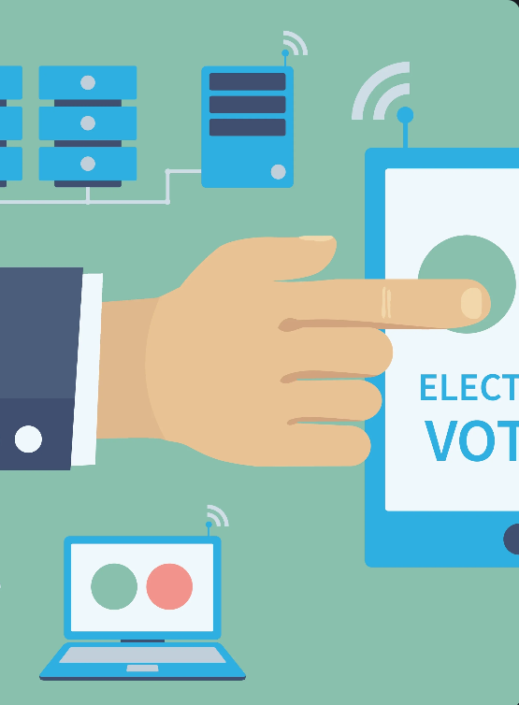
Online Voting Systems
GUIDED BY:- SUBMITED BY:-
Mr. MANJIT KUMAR NAYAK SNEHAL PRUSTY
2224100019

Slide 2
INTRODUCTION
Welcome to the future of voting! In this presentation, we will explore the benefits and challenges of online voting.
Electronic voting is an innovation that has improved the voting process as we know it. Today, we highlight some advantages and challenges of online voting.
Online voting is changing the way elections are held. With many countries(Switzerland , Estonia , India )already using online voting systems and more to follow, it's important to explore the benefits, concerns, and challenges of this technology.

Slide 3
EXISTING SYSTEM
There are already several online voting system available on the internet. Such as eVoting app,Electronic Runner,eBallot,eVote etc.
Still there exist some drawbacks to the existing system,such as:
There are no security for existing system.
Problem of hacking .
Showing the result to every one which person give to vote which one.

Slide 4
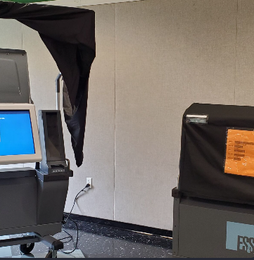
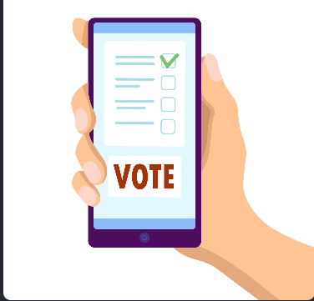
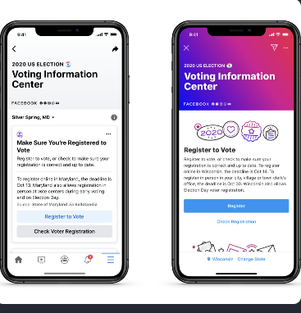
REAL- WORLD EXAMPLE
Traditional-voting
Electronic-Voting
Mobile-Voting
Long lines, limited hours, and inconvenient polling locations are among the challenges of traditional voting systems.
Electronic voting systems are gaining popularity due to their speed and efficiency, but concerns remain about software vulnerabilities and security.
Mobile voting systems are now being piloted in some areas, making it easier for people to vote without having to visit a polling site, but issues such as hacked phones and limited accessibility still need to be addressed.

Slide 5
Proposed System
My Proposed System provides for existing system as follows:
Digital Divide: Online voting could exacerbate the digital divide, as not everyone has equal access to the internet or the necessary technology to participate in online elections.
Voter Authentication: Verifying the identity of voters in an online setting is a critical issue. It is crucial to ensure that only eligible voters can cast their ballots and that they do so without coercion or influence..
Privacy Issues: Protecting voters' privacy and ensuring that their choices remain confidential is crucial in any voting system, but it becomes even more challenging in an online environment.

Slide 6
Voter Module
Voter Registration
Voter Login
Voter Dashboard - Voter can see his profile info, voting status, and list of groups
Voting - Voter can choose to vote to anyone group listed in his dashboard
Logout

Slide 7
Group Module
Group Registration
Group Login
Dashboard - Group can see its profile info, voting status, and list of groups
Voting - Group can choose to vote to anyone group listed in his dashboard
Logout

Slide 8
Software Requirement
Operating System : Window 10
Code Editor : Notepad/vs Code
Browser : Chrome/Firefox
XAMPP(X-operating system , Apache, Mysql , php , perl)

Slide 9
Technology Used
Frontend : HTML &CSS
Backend : php
Database : mySQL

Slide 10
Advantages
Voting accessibility : Online voting system reduces physical barriers, making casting one's ballot possible from any location and at any time.
Increased safety : Improvements in security measures have considerably decreased fraudulent activities during elections, ensuring transparent, safe, and fair voting process.
Time savings : Voters may cast their ballots from the comfort of their homes, thus saving time, effort and money.
With the ubiquitous use of smartphones, mobile apps for voting can increase voter participation and improve accessibility.
Innovative and convenient : Mobile voting allows young voters and individuals located abroad to be included in the democratic process rather than excluding them due to distance and time constraints.

Slide 11
ER Diagram

Slide 12
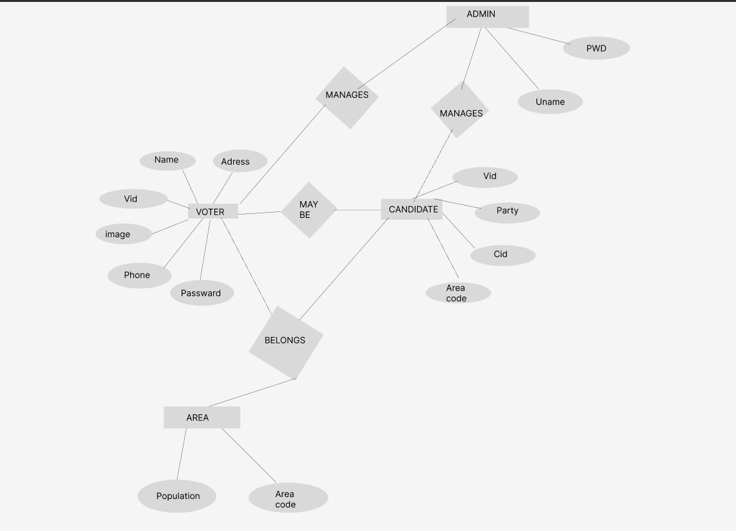

Slide 13
Use case Diagram

Slide 14
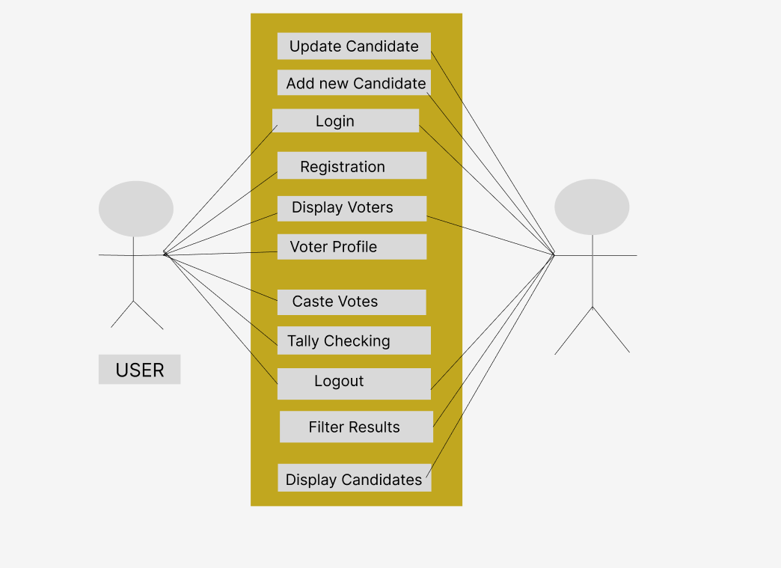
ADMIN

Slide 15
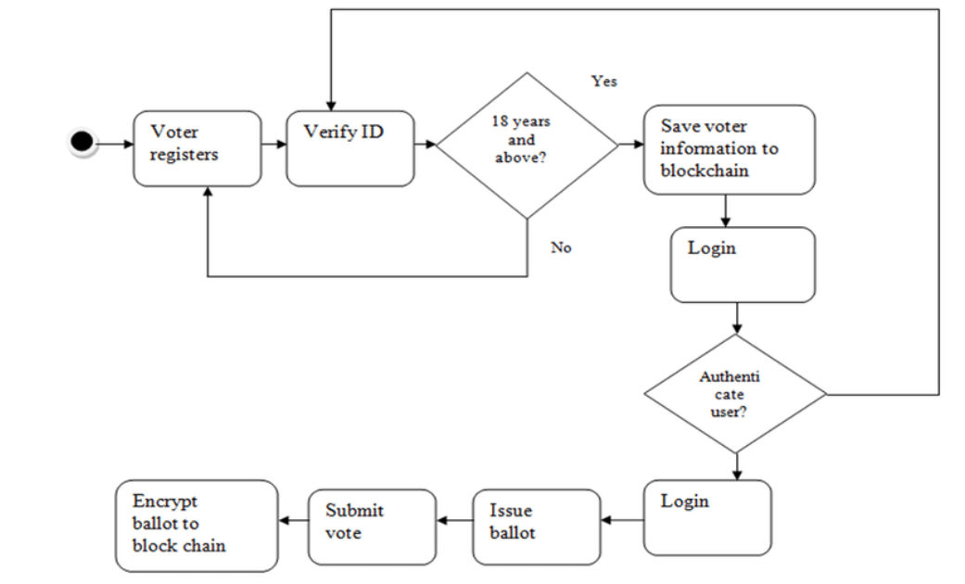
Activity flow Diagram of Admin side

Slide 16
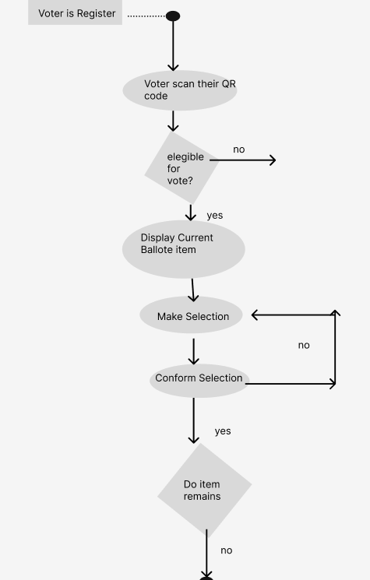
Activity flow Diagram of User side

Slide 17
Output Screen Snapshot

Slide 18
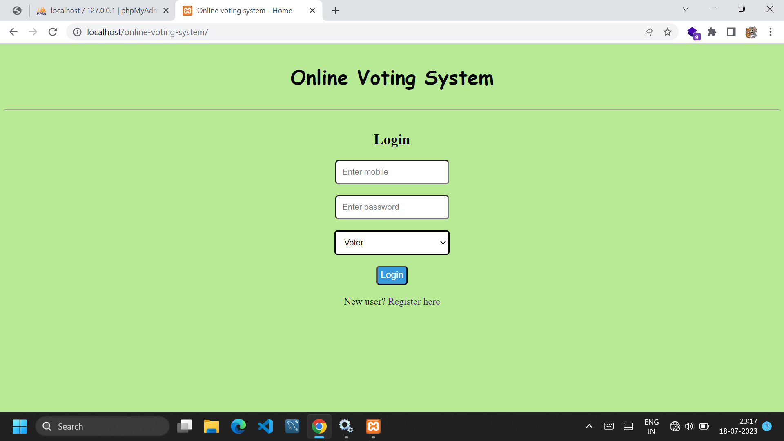
Login page

Slide 19
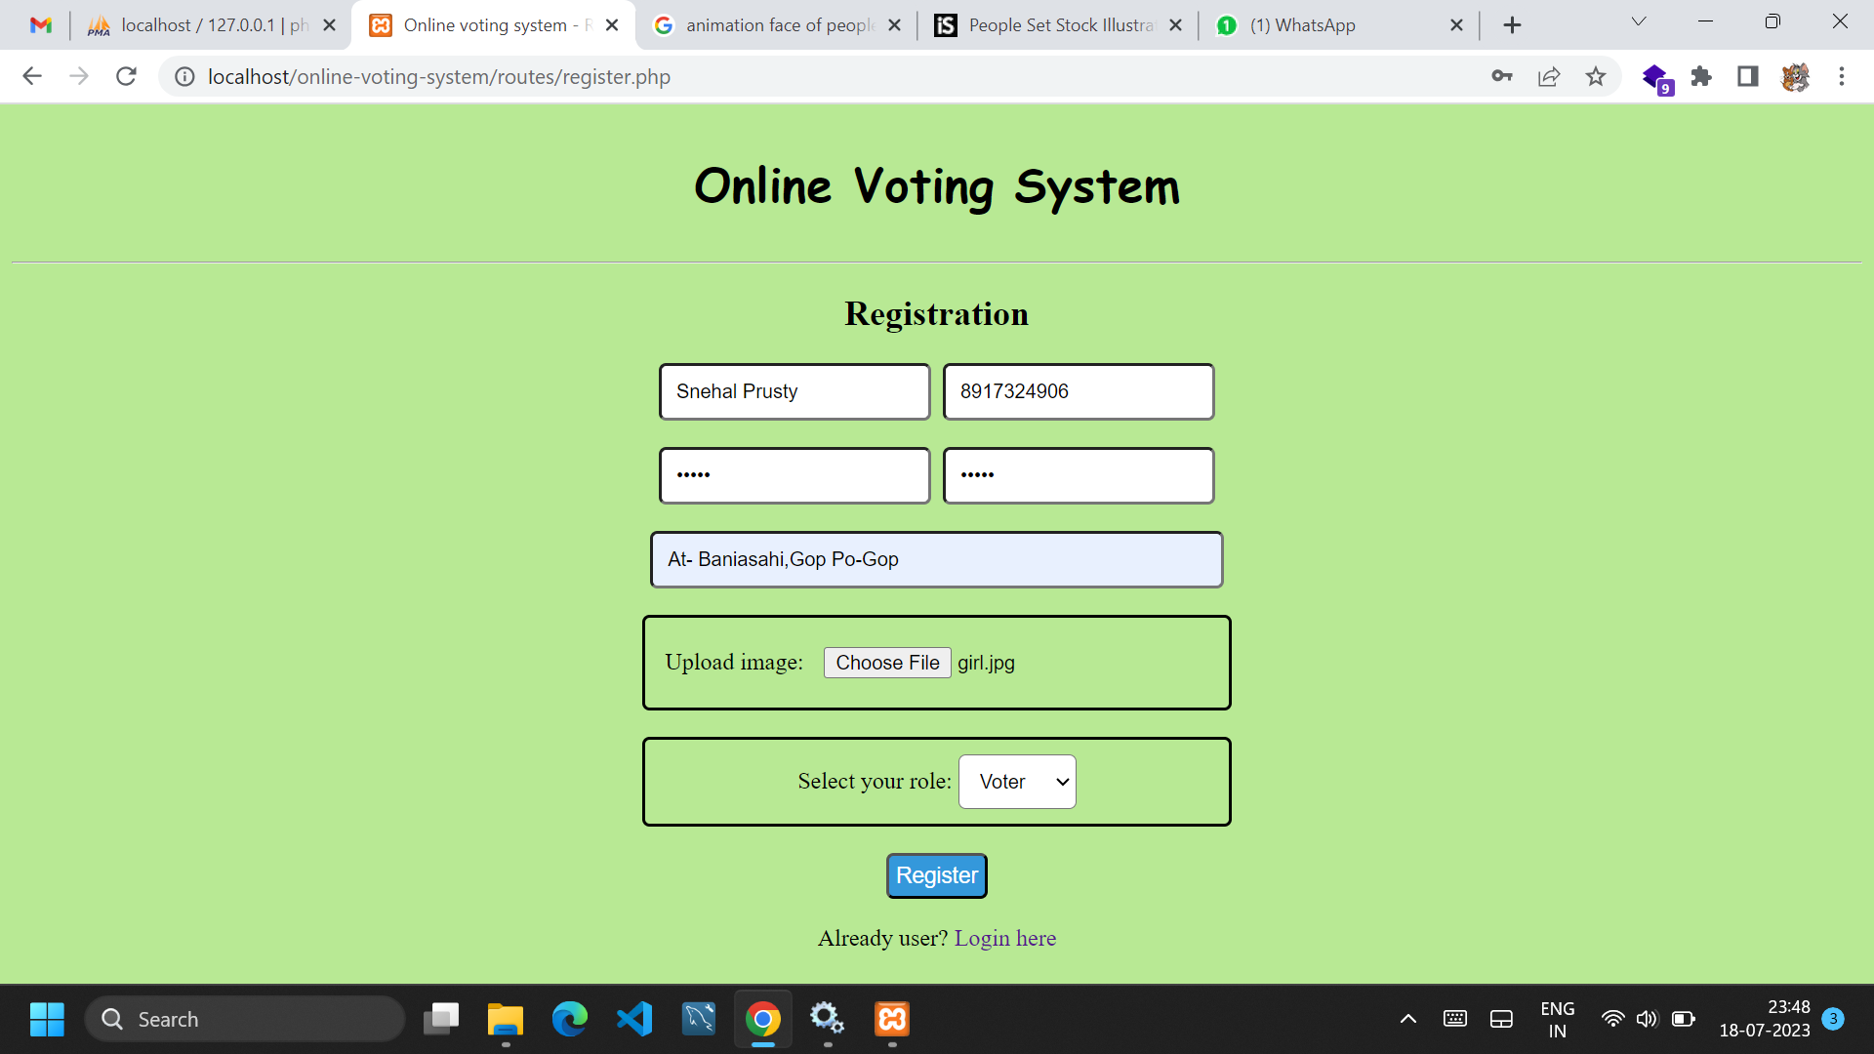
Registration Page

Slide 20
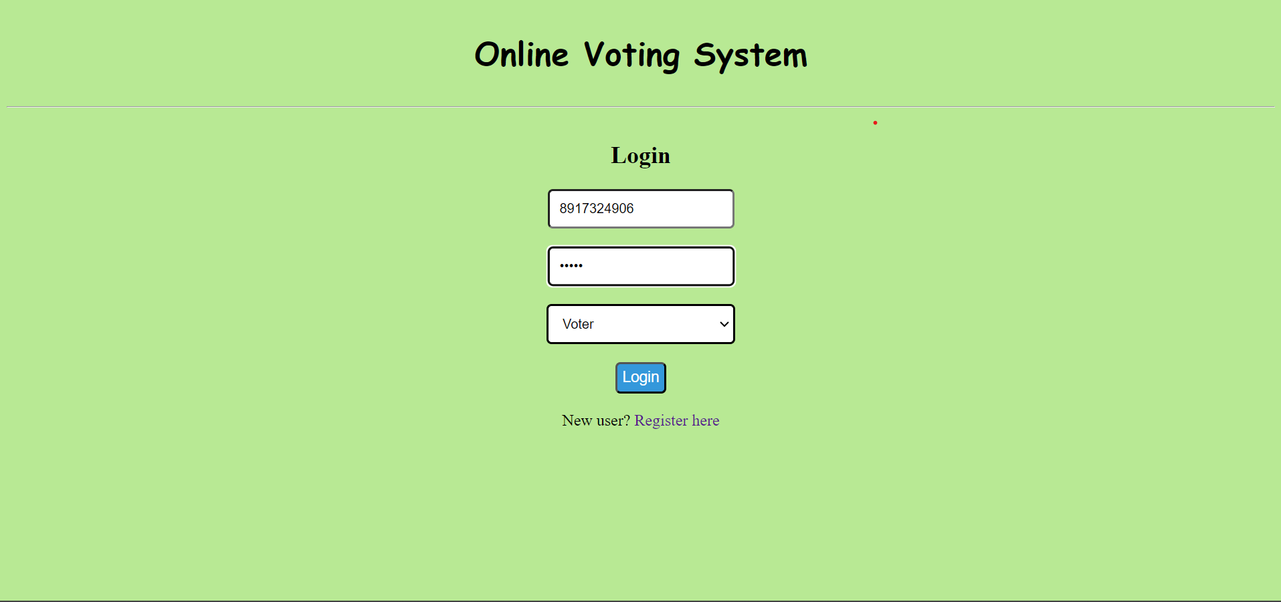
Login Page

Slide 21
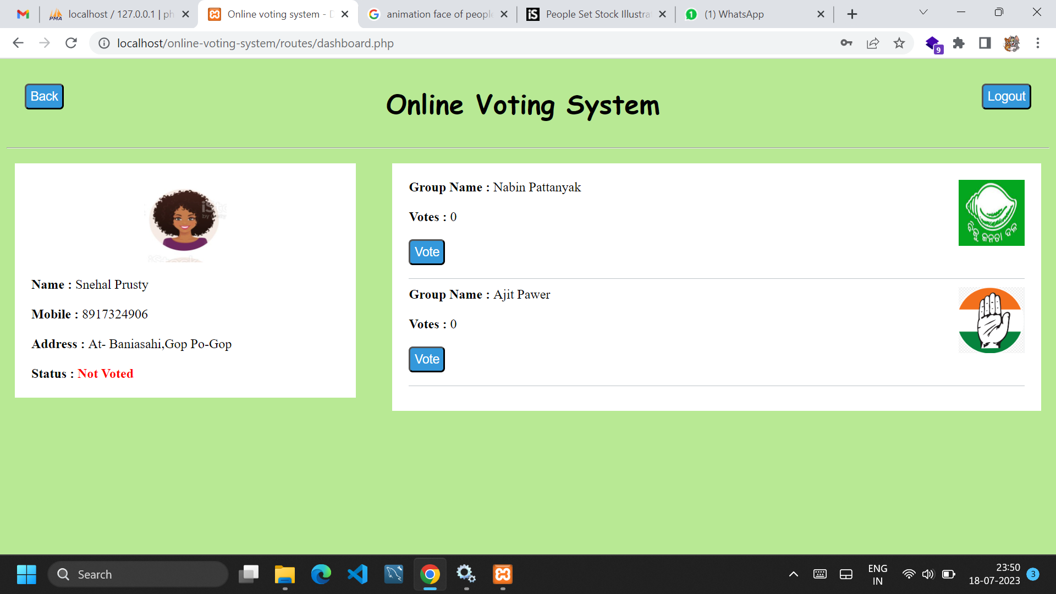
Dashboard page before voting

Slide 22
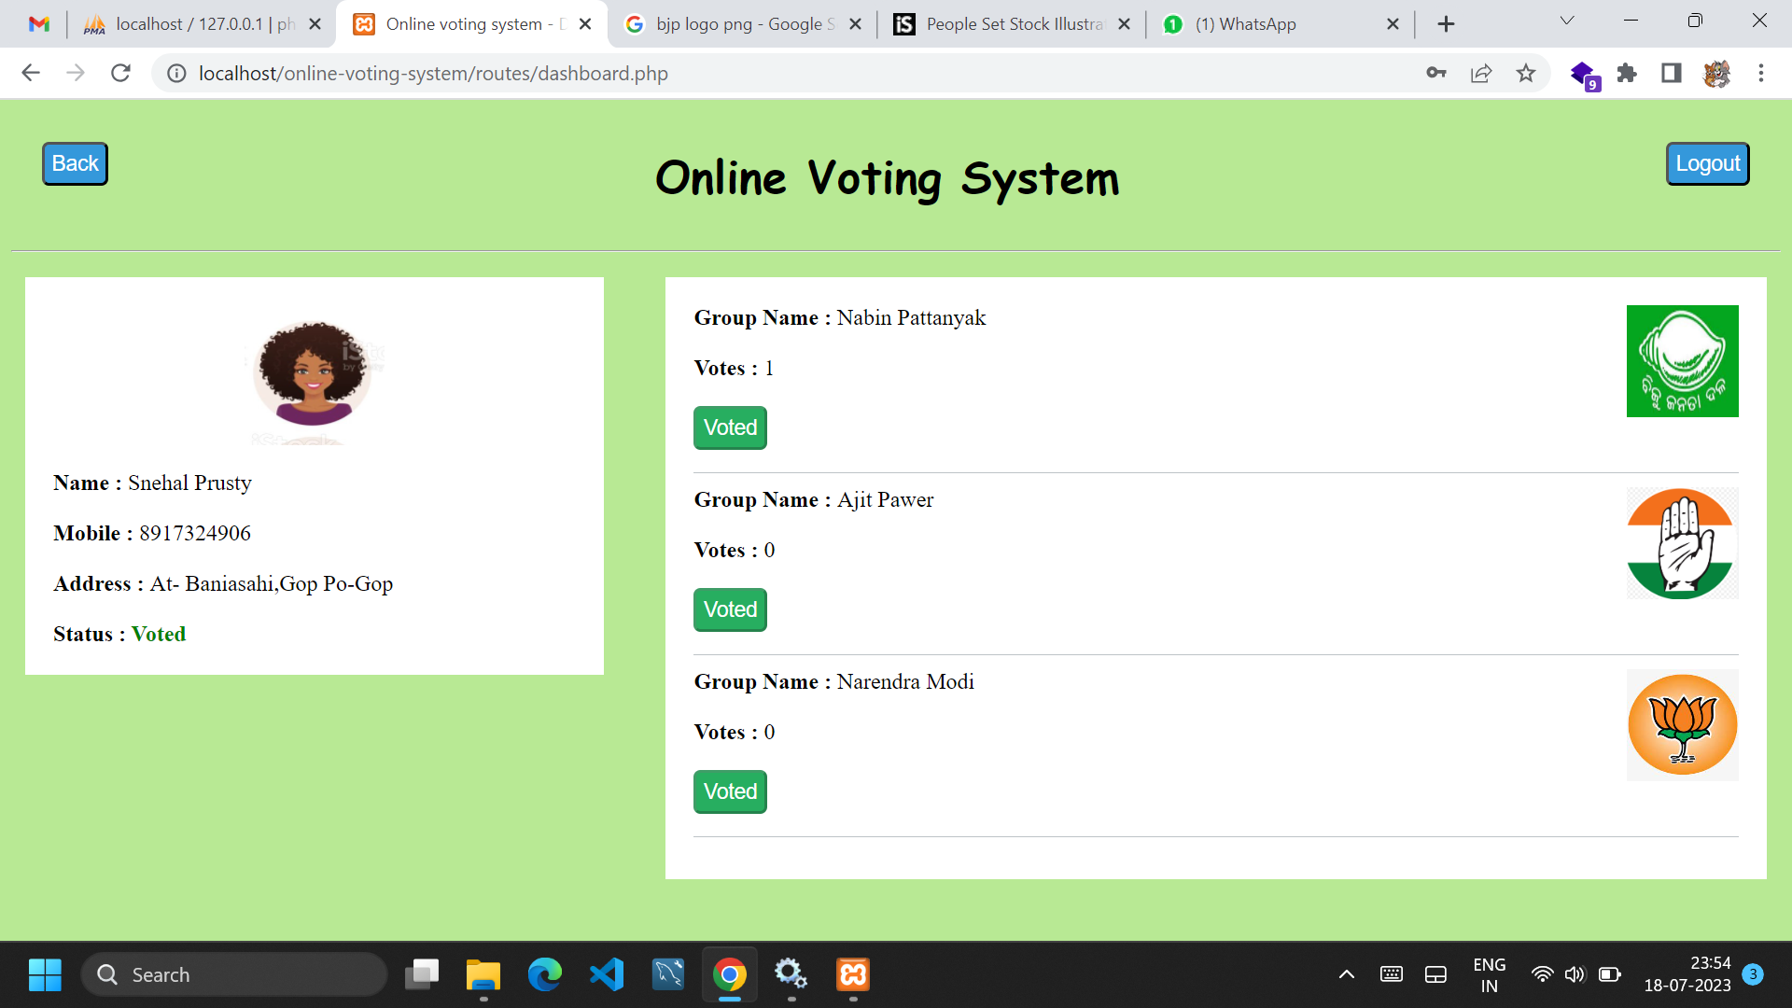
Dashboard page After voting

Slide 23
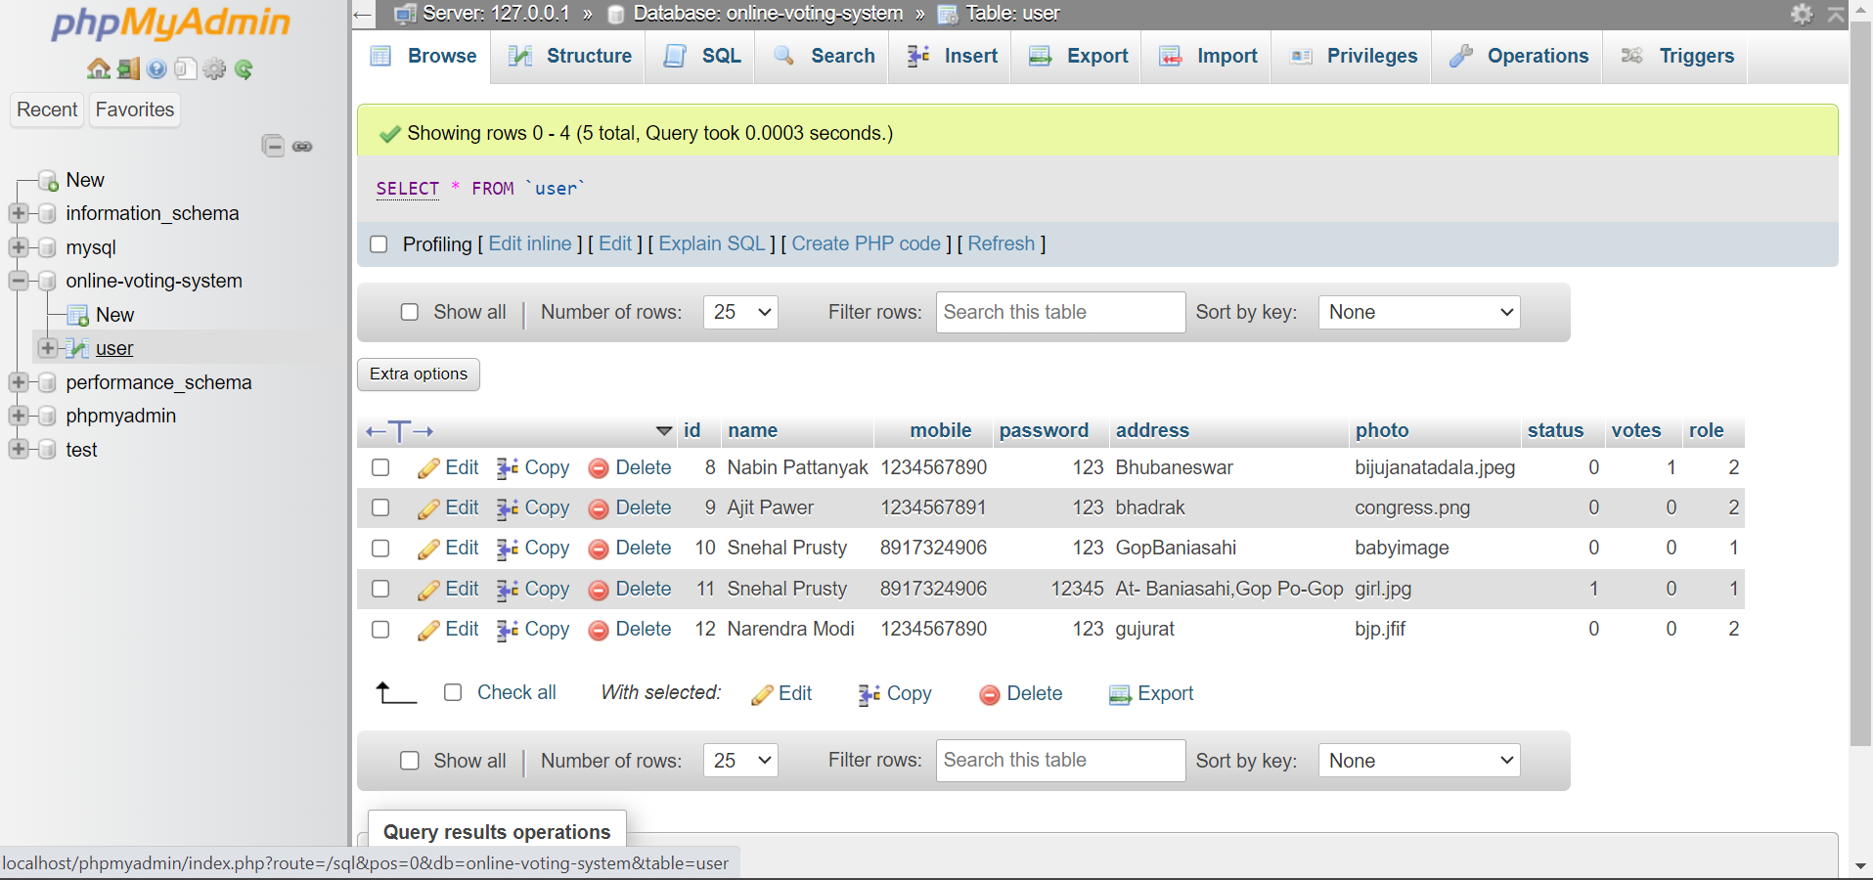
Database

Slide 24
Thank you !

